Slide 1

CRSS (PBGG) 8010:
Research Methods and Design in Crop Science
Jason Wallace Fall 2026
Lecture 16
Sums-of-Squares
freeimages.co.uk

Slide 2
Lecture outline
Administrative stuff
Review of last time
Model diagnostic plots
Sums of Squares

Slide 3
Administrative stuff
Major assignments still for class
  Exam 2 & Final Exam
  Practium – Start-to-finish analysis of a real-world dataset
    Start thinking now if there’s one of your own you want to use

Slide 4
Review:
Linear regression assumptions
Without looking at your notes, name as many assumptions of linear regression as you can.

Slide 5
Review:
Linear regression assumptions
Without looking at your notes, name as many assumptions of linear regression as you can.
  Linear relationship between dependent and independent variables
  No multicolinearity (= independent variables are not correlated with each other)
  Residuals are normally distributed
  Residuals are uncorrelated
  Homoscedasticity (=equal variance)

Slide 6

Review:
Model diagnostics
Download “16_sunflower.csv” on sunflower oil content.
  Fit a model & check your assumptions
  Plot the diagnostics
  Do you see any outliers or other problems?
  If so, how would you solve them?

Slide 7
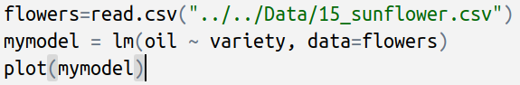
In-class exercise:
Model diagnostics
Code:

Slide 8
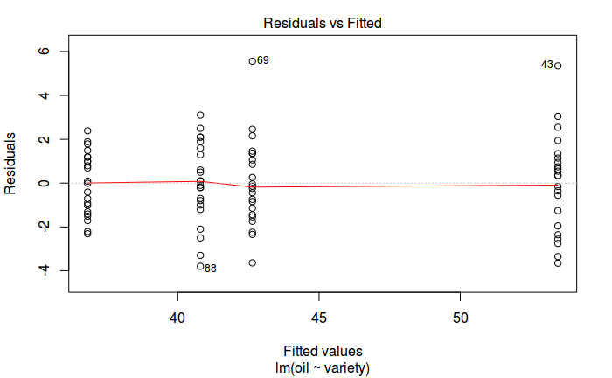
In-class exercise:
Model diagnostics
Possible outliers

Slide 9
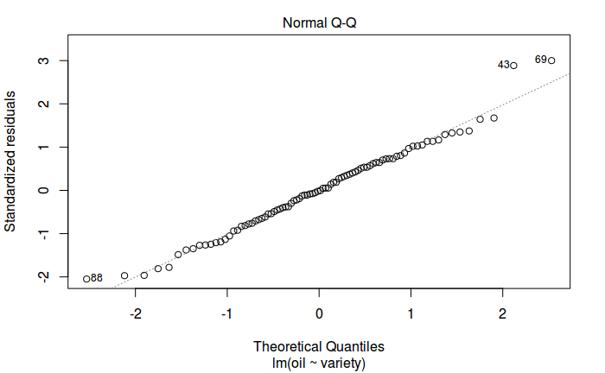
In-class exercise:
Model diagnostics

Slide 10
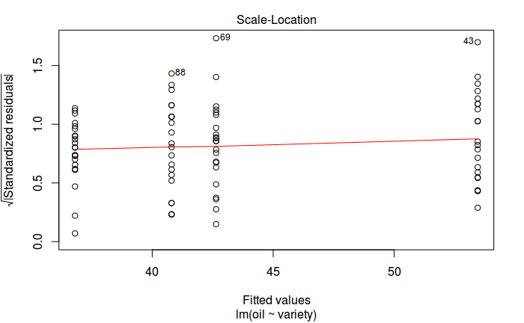
In-class exercise:
Model diagnostics

Slide 11
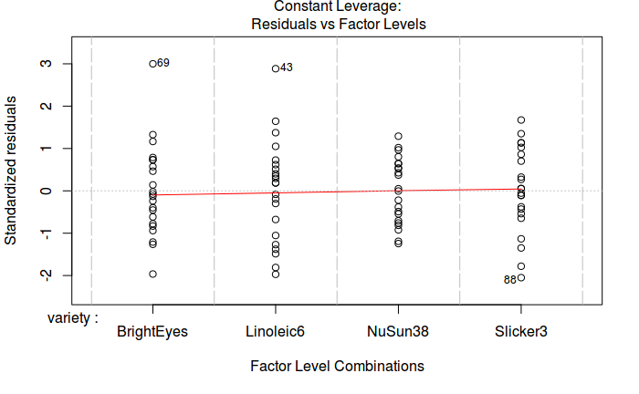
In-class exercise:
Model diagnostics

Slide 12
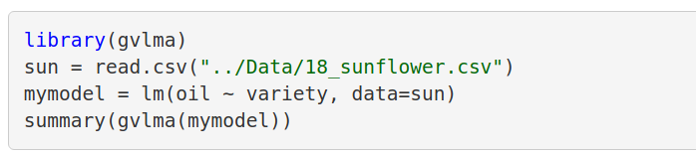
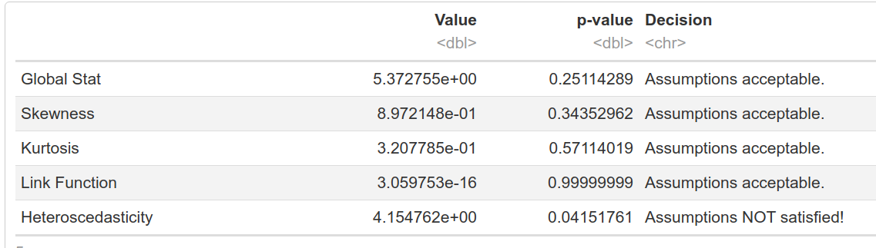
In-class exercise:
Model diagnostics
[…skipped model summary….]

Slide 13
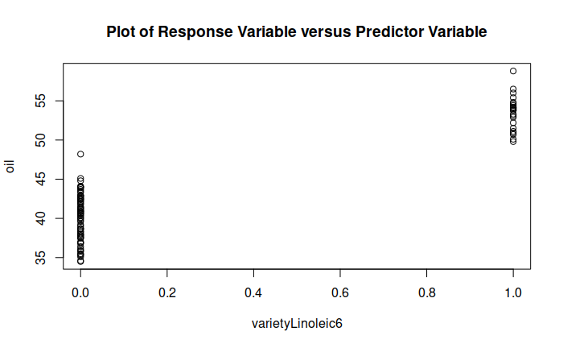
In-class exercise:
Model diagnostics
First several plots are looking at treatment levels

Slide 14
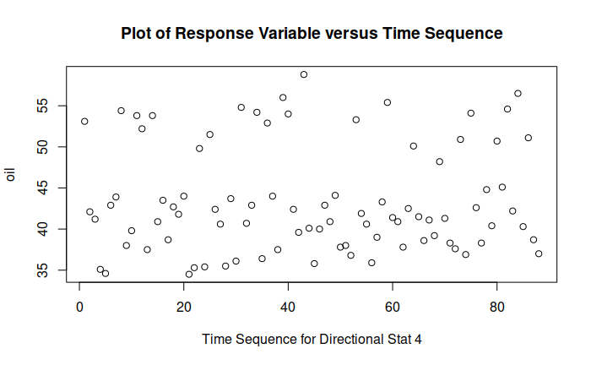
In-class exercise:
Model diagnostics
Next raw data (in order)

Slide 15
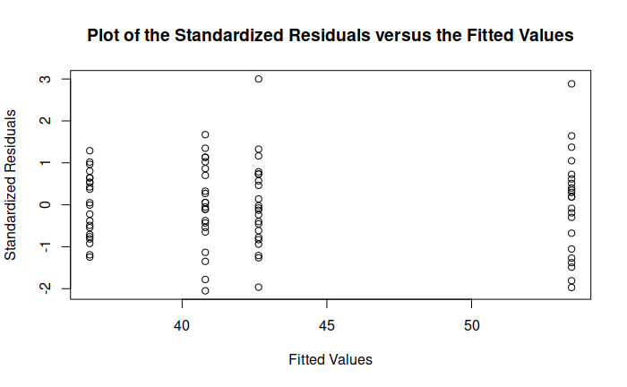
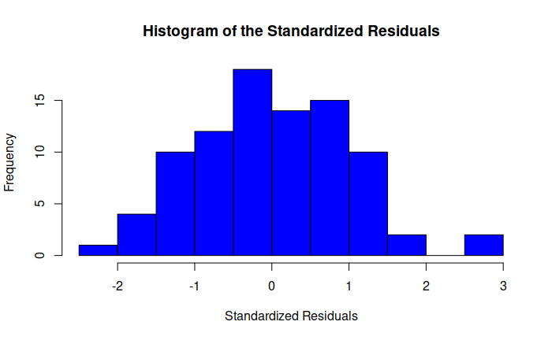
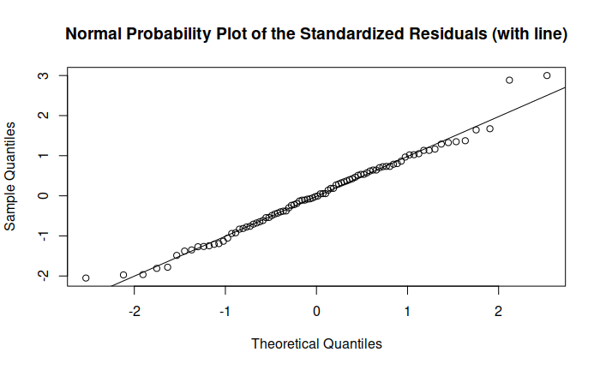
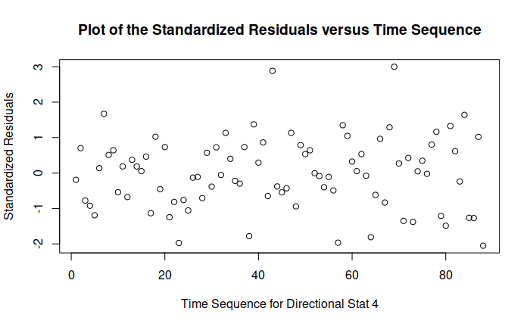
In-class exercise:
Model diagnostics
Fitted values vs residuals
Histogram
Next Residuals diagnostics
QQ plot
Residuals (in order)

Slide 16
Questions on last time’s material?

Slide 17

Balanced versus unbalanced data
Balanced data has equal observations of all treatment levels
Unbalanced data does not
  When you filter out bad data, you usually
  make your dataset unbalanced
  Many upcoming designs in this course are
  also inherently unbalanced
Kjpargeter / Freepik
Notes:
It’s okay to have unbalanced data, you just need to know how to treat it

Slide 18
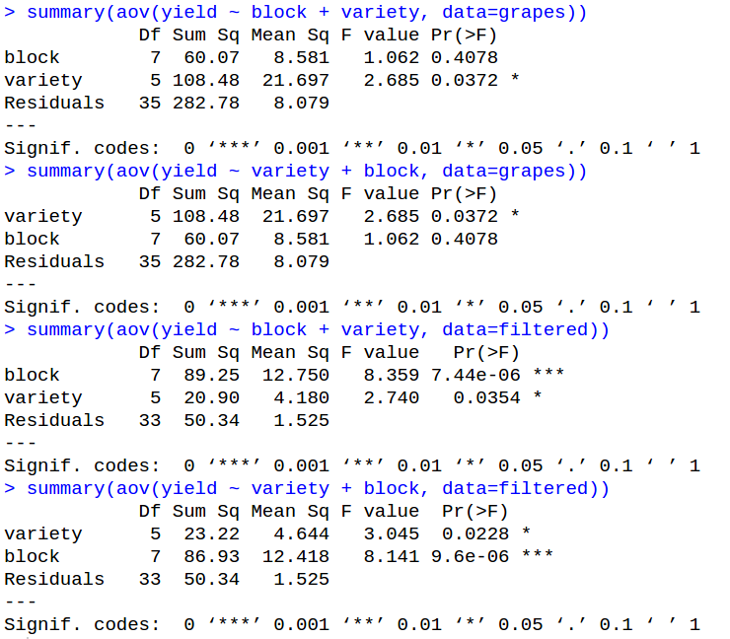
Order matters
In balanced data, the order you fit terms in ANOVA doesn’t matter
Notes:
This slide uses the muscadine dataset from 14_muscadines.csv, but the example works for any unbalanced data and with using lm()

Slide 19
Order matters
In unbalanced data, order does matter
Notes:
In this case the p-values are not hugely different, but they _are_ different, and the more unbalanced your data is the larger that difference will become

Slide 20
Sums-of-Squares
Most of this class has used balanced, complete designs without missing data
  Because of this, the sums-of-squares we’ve computed have all been independent of each other
Now we’re getting into some designs where that is not the case, so order matters
  Note: this all specifically refers to linear models; missing data in a true ANOVA analysis is much harder to deal with

Slide 21
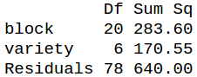
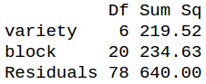
How order affects Sums of Squares
Note a specific pattern in the SS calculations:
Block first
Variety first
Loses SS
Gains SS
No change for residuals
For unbalanced data, model order doesn’t change the total SS, but does change who gets how much

Slide 22
How order affects Sums of Squares
Note a specific pattern in the SS calculations:
Block first
Variety first
454.15
454.15
For unbalanced data, model order doesn’t change the total SS, but does change who gets how much
  Loss from one term exactly balanced by gain by another

Slide 23

Linear regression is greedy
Linear regression is “greedy”
  This means earlier model terms take as much SS as possible
In balanced data, you can uniquely assign the model SS to individual terms
In unbalanced data, some SS are “shared” among terms
  Whichever term comes first gets all of it
  Any later terms get whatever’s left

Slide 24
Sharing Sums of Squares
Balanced Data
Total Sums of Squares
outcome ~ A + B

Slide 25
Sharing Sums of Squares
Balanced Data
Factor A
SS
Total Sums of Squares
Factor B
SS
Residual SS
outcome ~ A + B

Slide 26
Sharing Sums of Squares
Balanced Data
Unbalanced
Factor B
SS
Factor A
SS
Total Sums of Squares
Total Sums of Squares
Residual SS
outcome ~ B + A

Slide 27
Sharing Sums of Squares
Balanced Data
Unbalanced
Factor B
SS
Factor A
SS
Factor A
SS
Factor B
SS
Total Sums of Squares
Total Sums of Squares
Residual SS
Factor A or B SS
Residual SS
outcome ~ B + A
Notes:
Unbalanced data has some SS that we cannot tell which factor it belongs to because we don’t have equal observations of everything

Slide 28
Sharing Sums of Squares
Balanced Data
Unbalanced
Factor B
SS
Factor A
SS
Factor A
SS
Factor B
SS
Residual SS
Factor A or B SS
Residual SS
outcome ~ B + A
outcome ~ A + B
Notes:
When A is fit first, it “absorbs” the ambiguous SS into itself

Slide 29
Sharing Sums of Squares
Balanced Data
Unbalanced
Factor B
SS
Factor A
SS
Factor B
SS
Factor A
SS
Residual SS
Factor A or B SS
Residual SS
outcome ~ B + A
outcome ~ B + A
Notes:
When B is fit first, it “absorbs” the ambiguous SS into itself

Slide 30
In-class exercise:
Balance and model order
Download the data “16_balanced.csv”, a simple RCBD
  Do an ANOVA swapping the block and variety terms and show that the results are identical
  You realize that variety A51 had seedlot issues. Remove all its data from the dataset. Is the data still balanced?
  You also find out that in block 4, variety C11 was planted with the wrong seed. After you remove it, is the data still balanced?

Slide 31
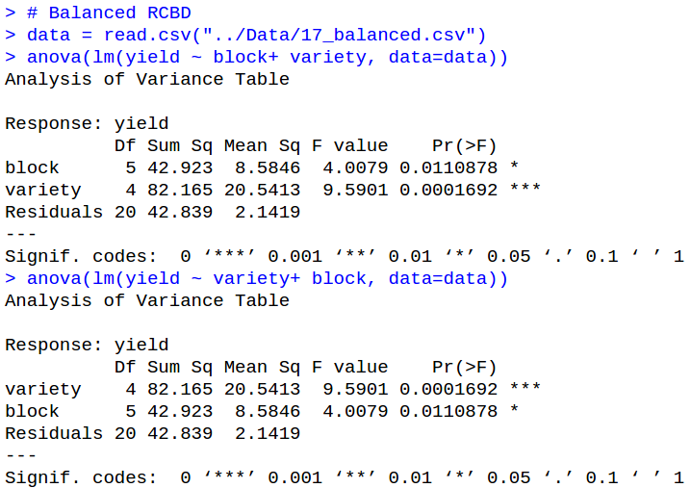
In-class exercise:
Balance and model order
Identical SS

Slide 32
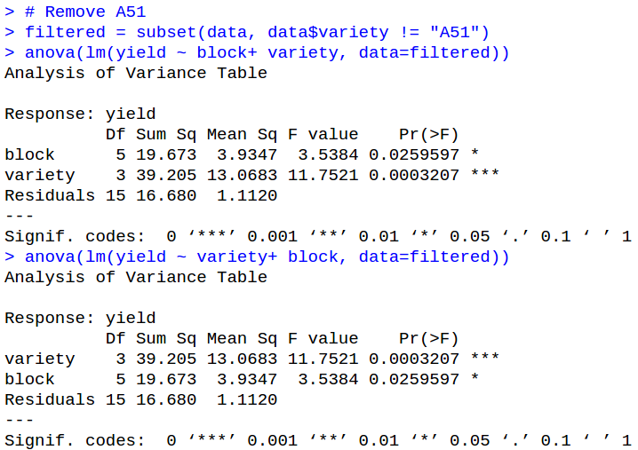
In-class exercise:
Balance and model order
Still balanced
(because removed all of one variable)

Slide 33
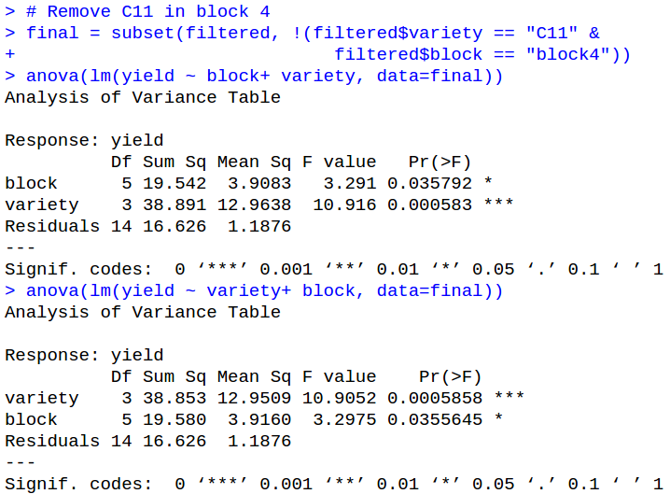
In-class exercise:
Balance and model order
One of several ways to filter
Now unbalanced
(though just barely because only a little unbalanced)

Slide 34
Questions on model order and SS?

Slide 35
So what is the correct model order?
Because regression is greedy, earlier model terms get more SS
This increases their mean square and F statistic, making them more likely to be significant
The general rule is:
  Nuisance variables (blocks, etc.) go first
  Things you care about go last
What’s the danger if you do it the other way?
Notes:
If you put the things you care about first, you risk them “absorbing” variance that isn’t actually theirs (block effects, etc). By putting the things you care about last, you guarantee they only contain the effect of what can be uniquely assigned to them.

Slide 36
The types of sums-of-squares
There are three ways to compute the sums-of-squares for linear models
Each one makes different assumptions.
  They seem to have been arbitrarily defined by SAS, and the names/methodologies stuck
  There is no single “best” way; it all depends on what you are looking for
Type I
Type II
Type III
Notes:
Good resource for this: https://mcfromnz.wordpress.com/2011/03/02/anova-type-iiiiii-ss-explained/

Slide 37
Type I Sums-of-Squares
Type I
Type I sums-of-squares are also called “sequential” sums-of-squares
With this method, the sums-of-squares are computed in the order that terms are entered into the model
y ~ factor1 + factor2 + factor3
Response variable

Slide 38
Type I Sums-of-Squares
Type I
Type I sums-of-squares are also called “sequential” sums-of-squares
With this method, the sums-of-squares are computed in the order that terms are entered into the model
y ~ factor1 + factor2 + factor3
Response variable
First compute how much SS this accounts for

Slide 39
Type I Sums-of-Squares
Type I
Type I sums-of-squares are also called “sequential” sums-of-squares
With this method, the sums-of-squares are computed in the order that terms are entered into the model
y ~ factor1 + factor2 + factor3
Response variable
Next, determine how much of what remains this accounts for
First compute how much SS this accounts for

Slide 40
Type I Sums-of-Squares
Type I
Type I sums-of-squares are also called “sequential” sums-of-squares
With this method, the sums-of-squares are computed in the order that terms are entered into the model
y ~ factor1 + factor2 + factor3
Response variable
Next, determine how much of what remains this accounts for
Finally, do the same for this one, again using only the remaining SS
First compute how much SS this accounts for
Notes:
The end result of this is that the later model terms are computed after accounting for the earlier ones, meaning the earlier model terms are “controlled for.” In practice, this means you want to put your nuisance variables—the ones you need to be aware of but don’t actually care about, like blocks, people who did the scoring, etc.—earlier in the model than the variables you do care about (plant variety, etc.)

Slide 41

In-class exercise:
Type I Sums-of-Squares
Consider a full factorial design with 20 cotton
varieties, 4 scorers, and 5 reps in RCBD
Several plots in one block got eaten by deer, so data is missing
What order do you put the model in?
  fiber ~ variety + block + scorer
  fiber ~ block + scorer + variety
  fiber ~ scorer + variety + block
Notes:
Note: each block has 80 treatments total

Slide 42
In-class exercise:
Type I Sums-of-Squares
Consider a full factorial design with 20 cotton
varieties, 4 scorers, and 5 reps in RCBD
Several plots in one block got eaten by deer, so data is missing
What order do you put the model in?
  fiber ~ variety + block + scorer
  fiber ~ block + scorer + variety
  fiber ~ scorer + variety + block
All are statistically valid, but since you probably only care about variety, it should go last (=most honest assessment)
Notes:
Note: each block has 80 treatments total

Slide 43
In-class exercise:
Type I Sums-of-Squares
What about this situation:
  3 fertilizers, 2 irrigation schemes, and 6 maize varieties in a full factorial RCBD with 3 replicates
Which factor would you put last?
  Block
  Fertilizer
  Irrigation
  Maize variety

Slide 44
In-class exercise:
Type I Sums-of-Squares
What about this situation:
  3 fertilizers, 2 irrigation schemes, and 6 maize varieties in a full factorial RCBD with 3 replicates
Which factor would you put last?
  Block
  Fertilizer
  Irrigation
  Maize variety
Not this one; block is almost always a nuisance variable
You’re probably interested in all of these, and probably their interactions, too. But you can only put 1 term in last place

Slide 45
Type I Sums-of-Squares
Type I
This is the great limitation of Type I sums-of-squares. It is easy to do and accurate for the total model, but less so for individual model parts
To get more honest results, we have to use the other types

Slide 46
Type II Sums-of-Squares
Type II
Type II Sums-of-Squares gives you the SS value of each main effect after fitting all other main effects
  Basically, the model is fit multiple times, each time with a different effect in last place
  Higher-order interactions are ignored; this can be dangerous if interactions are significant
Note: the sum of individual Type II SS values will not equal the total model SS.
Notes:
Pretty sure if you sum the Type II and Type III SS for each factor, it is always _less than_ the total model SS. Haven’t rigorously checked this, though.

Slide 47
Type II Sums-of-Squares
Type II
Going back to our example:
  3 fertilizers, 2 irrigation schemes, and 6 maize varieties in a full factorial RCBD with 3 replicates
Type II sums-of-squares will return:
  SS of fertilizer after fitting irrigation and variety
  SS of irrigation after fitting fertilizer and variety
  SS of variety after fitting fertilizer and irrigation

Slide 48
Type II Sums-of-Squares
Type II
Type II SS is probably the best if:
  You don’t have any interaction terms
  You already tested the interactions and they are not significant
By definition, Type II SS cannot test interactions
  This is obviously a big problem if you care about them
  You can, however, make a pseudo-Type II SS for interaction terms by just fitting them last.
    (This is how you’d test to see if they’re significant or not.)

Slide 49
Type III Sums-of-Squares
Type III
Type III SS is very similar to Type II, except that you calculate SS for each effect after accounting for all other main effects and their interactions

Slide 50
Type III Sums-of-Squares
Type III
Going back to our example:
  3 fertilizers, 2 irrigation schemes, and 6 maize varieties in a full factorial RCBD with 3 replicates
Type III sums-of-squares will return:
  SS of fertilizer after fitting:
    Irrigation
    Variety
    Fertilizer:Variety
    Irrigation:Variety
    Fertilizer:Irrigation:Variety
  Same idea for the other factors

Slide 51
Type III Sums-of-Squares
Type III
If you’re interested in interactions, type III SS is frequently your best bet
However, if your interactions are significant, the interpretation of your main effects are not always clear

Slide 52
Sums-of-squares summaries
Type I
  Everything added in order
  Easiest; default for R
  Use if you have balanced data
Type II
  Tests effects after all other effects of the same order or lower
  More power than Type III if higher-order interactions are not significant; dangerous/wrong if they are
Type III
  Tests all terms after including all other terms
  Generally what you’re interested in, but can have interpretation issues

Slide 53
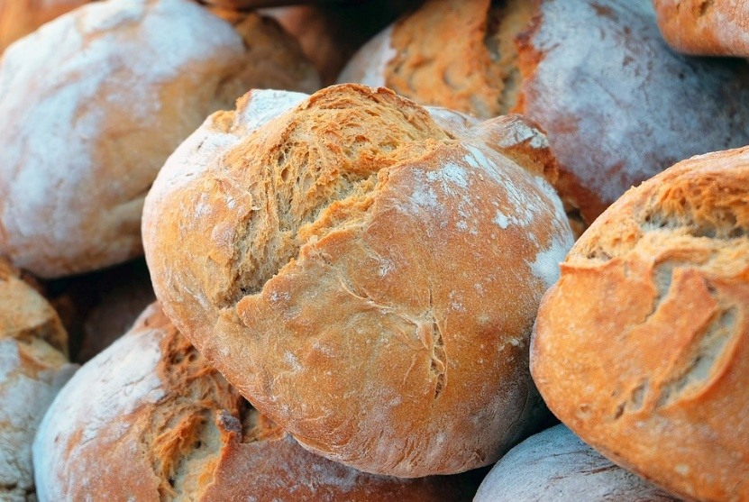
Sums-of-squares examples:
Example 1: Breadmaking quality in wheat
  25 wheat varieties
  6 reps in RCBD, each in a different field
What formula would you use?
What type of SS would you use?

Slide 54
Sums-of-squares examples:
Example 1: Breadmaking quality in wheat
  25 wheat varieties
  6 reps in RCBD, each in a different field
What formula would you use?
  Quality ~ block + variety
What type of SS would you use?
  Probably just Type I, since not interested in block
  Note: Cannot test interactions because blocks are not replicated

Slide 55

Sums-of-squares examples:
Example 2: Insect damage in blueberries
  6 integrated pest management variations
  10 blueberry varieties
  4 reps in a CRD with missing data
What formula would you use?
What type of SS would you use?

Slide 56
Sums-of-squares examples:
Example 2: Insect damage in blueberries
  6 integrated pest management variations
  10 blueberry varieties
  4 reps in a CRD with missing data
What formula would you use?
  Damage ~ ipm + variety + ipm:variety
What type of SS would you use?
  Probably Type III since care about both main effects and interaction
  But maybe Type II if the ipm:variety term is not significant/important

Slide 57
Sums-of-squares summaries
The different types of sums-of-squares are tools, each with their own niche
  If your data is balanced and complete (no missing data), there’s no need to go beyond Type I
  Use Type II if you don’t care about interactions
  Use Type III if you do

Slide 58
Questions on the types of SS?

Slide 59
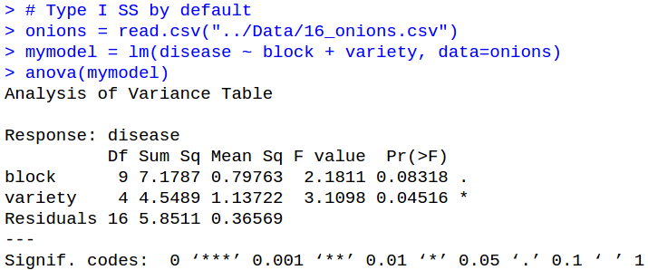
Sums-of-squares in R
R does Type I SS by default; no need to do anything fancy
Type I SS

Slide 60
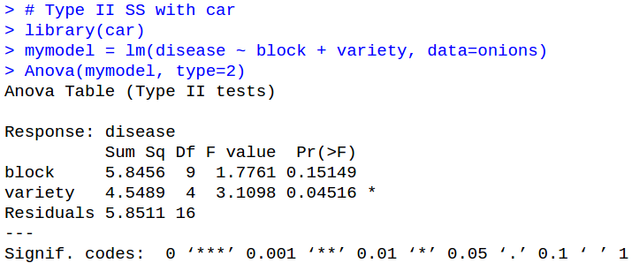
Sums-of-squares in R
Type II and Type III accessible through the “car” package
Load library
Specify which type to use (2 or 3)
Note the capital letter; this is not the same function as anova()

Slide 61
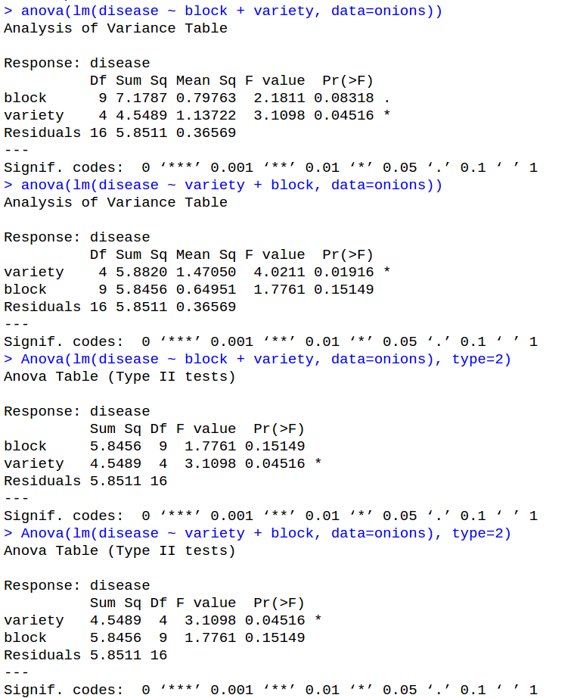
Type I versus Type II
Type I
Order Matters
Type II
Order Doesn’t Matter

Slide 62
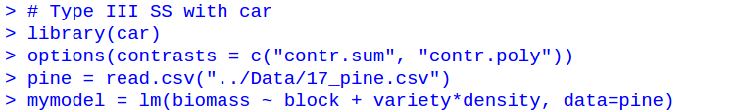
Sums-of-squares in R
Type III SS requires an extra line of code
Specifies the type of contrasts the model uses; R’s defaults are not appropriate for Type III SS
Notes:
options(contrasts = c(“contr.sum”,”contr.poly”))

Slide 63
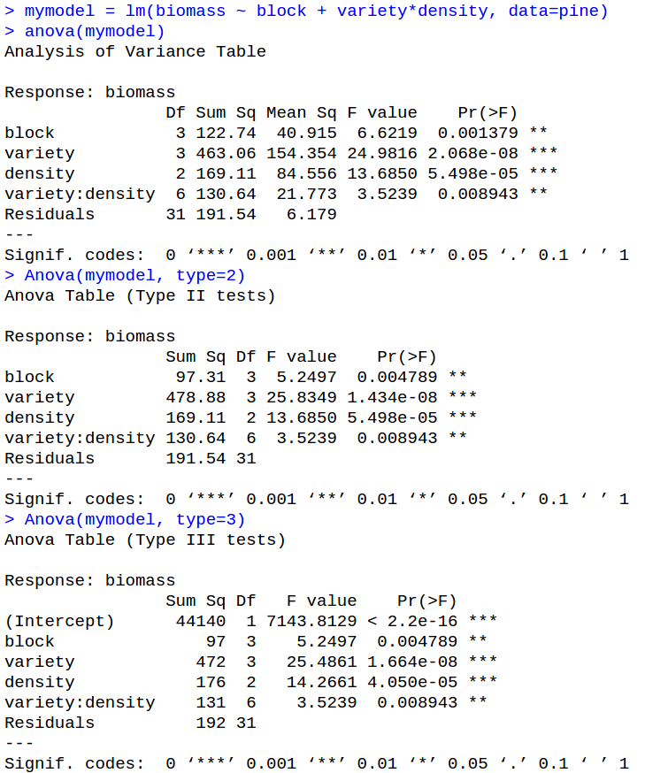
Sums-of-squares in R
Notes:
options(contrasts = c(“contr.sum”,”contr.poly”))

Slide 64
In-class exercise:
Sums of squares
Load “16_peanuts.csv” and do an ANOVA analysis
  Which SS method is most appropriate for this dataset?
  Run an ANOVA with that method
Code for enabling Type III SS if you need it:
  options(contrasts = c("contr.sum", "contr.poly"))

Slide 65
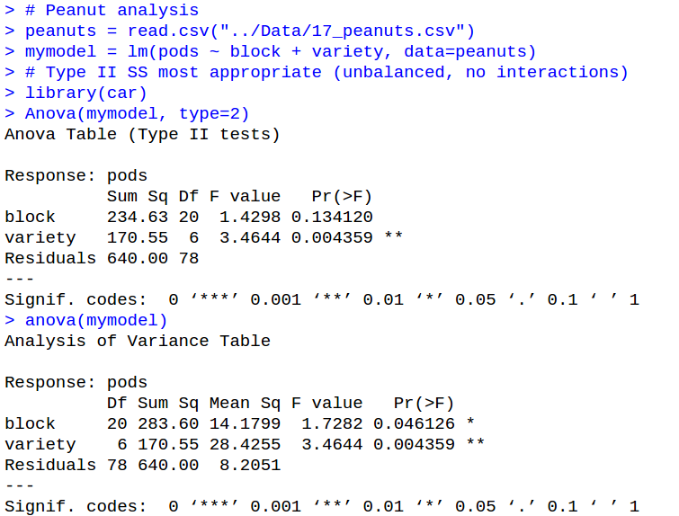
In-class exercise:
Sums of squares

Slide 66
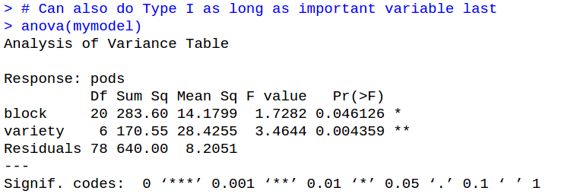
In-class exercise:
Sums of squares

Slide 67
Final questions on Sums of Squares?

Slide 68
Homework 6
Due before class Thursday (Oct 15)
  Response by start of Tuesday class (Oct 20)

Slide 69
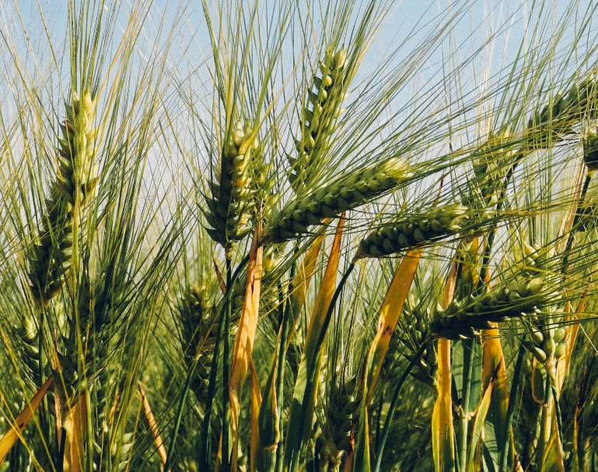
Exercise 1:
Linear Regression
Download the dataset “16_malting.csv”, containing a test of barley malting quality at a combination of planting densities and planting depths.
  What kind of design is this?
  Run an ANOVA analysis on this data using both aov() and anova()
    Confirm that the results are the same for each factor
  Which factor(s) is/are significant?
    If there are any significant interactions, plot them.

Slide 70
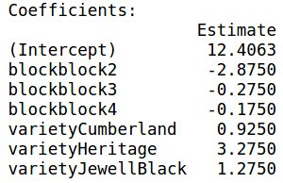
Exercise 2:
Fill out the model table
(subset of full data)
Block | Variety | Yield
block1 | Anne | 12.0
block2 | Heritage | 13.4
block2 | Cumberland | 9.1
block3 | Anne | 12.5
block4 | JewellBlack | 12.9
intercept | block1 | block2 | block3 | block4 | Anne | Cumberland | Heritage | JewellBlack
12.406
12.406 |  | -2.875 |  |  |  |  | 3.275
12.406 |  | -2.875 |  |  |  | 0.925
12.406 |  |  | -0.275
12.406 |  |  |  | -0.175 |  |  | 1.275
Total | Actual | Error
12.4063 | 12.0 | 0.4063
12.8063 | 13.4 | -0.5937
10.4563 | 9.1 | 1.3563
12.1313 | 12.5 | -0.3687
13.5063 | 12.9 | 0.6063

Slide 71
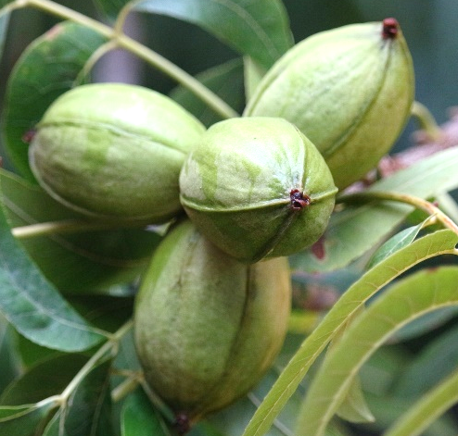
Exercise 3:
Quality control
Download the data “16_pecans.csv”, containing a RCBD factorial with pecan varieties and fungicide treatment
  Fit a model with interactions
  Plot both the raw data and residuals. Are there any problems?
    Double-check with gvlma()
  If you found problems, fix them by removing the problematic data points and fitting the model again. Then show that the problem is fixed.

Slide 72
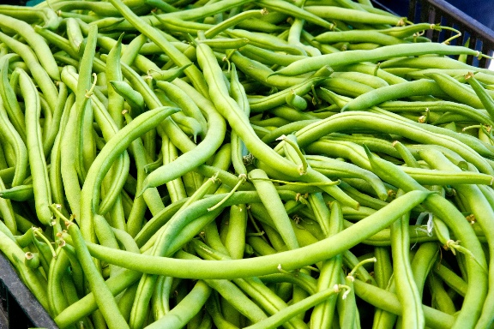
Exercise 4:
Sums of Squares
Download the dataset “16_beans.csv”, which is a full factorial RCBD of green bean disease resistance.
  Treatment 1 = bean variety
  Treatment 2 = inoculant for nitrogen fixation
  About 20% of plots had to be discarded due to deer damage
Run an analysis of this data, including using the correct SS for ANOVA and finding the best treatment(s).
  Remember to import the car library if you want Type 2 or Type 3
  Remember to include the below code if you want type 3:
    options(contrasts = c("contr.sum", "contr.poly"))

Slide 73
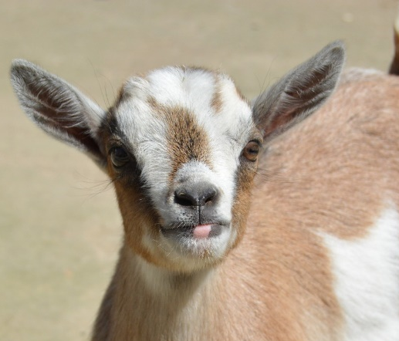
Exercise 5:
Experimental Design
You are designing an experiment to look at combinations of probiotics and antibiotics to boost the growth of baby goats. You have:
  3 antibiotics: None, Tetracycline, Lincomycin
  4 probiotics: None, Lactobacillus, Enterococcus, Bifidobacteria
  3 barns, each of which has 32 pens that can hold 5 goats each
  An unlimited supply of baby goats
What would be the best design for this experiment?
  How many DOF will you have for each term (& for error)?
  Create this design in R and export the data table (=fieldbook).

